Slide 1
PART.1
Project Highlights:
XX
XX
RECORD THE UPDATE AND
ALERT WHEN ITEMS ARE LOW
XX
XX
VINCENT AND KARINA
New Methods:
KARINA
StockChecker::startChecking(): Initiates the inventory check feature, causing it to perform periodic checks.
StockChecker::stopChecking(): Halts the inventory check feature, pausing the check operation.

Slide 2
PART.2
Register_Data_Introduction

Slide 3
PART.3
REGISTRATION WAY: HTML AND SCRIPT

Slide 4
PART.3
REGISTRATION WAY: HTML AND SCRIPT

Slide 5

PART.4
Introduction to the Inventory Check Feature:
INTRODUCTION
The inventory check feature is designed to monitor the real-time stock levels of a specific item and trigger an alert when the stock falls below a set threshold. To implement this functionality, the StockChecker class and related methods have been introduced.
VINCENT

Slide 6
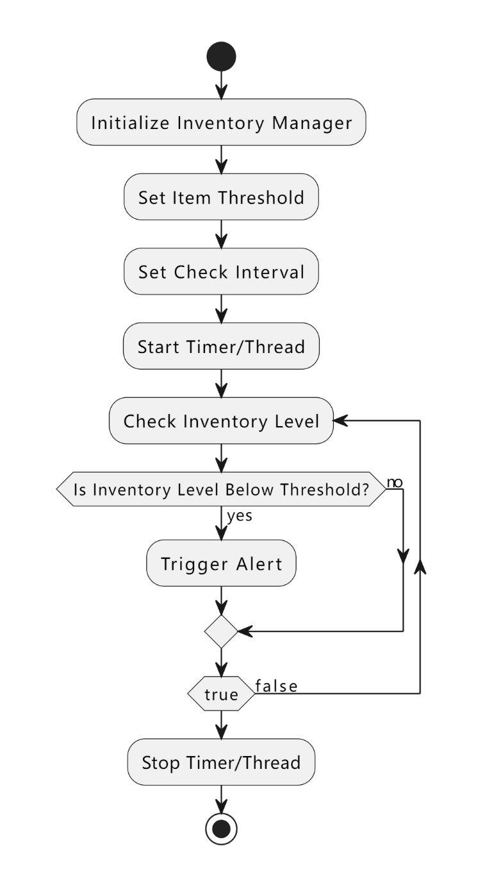
PART.4
NEW CLASS: StockChecker
CREATE CLASS TO EXCUTE STOCK CHECK
StockChecker Class:
The StockChecker class is responsible for periodically checking the stock levels of a specific item.
It utilizes mechanisms such as timers or threads to ensure that the check operation is executed at set intervals.
New Methods:
StockChecker::startChecking(): Initiates the inventory check feature, causing it to perform periodic checks.
StockChecker::stopChecking(): Halts the inventory check feature, pausing the check operation.

Slide 7
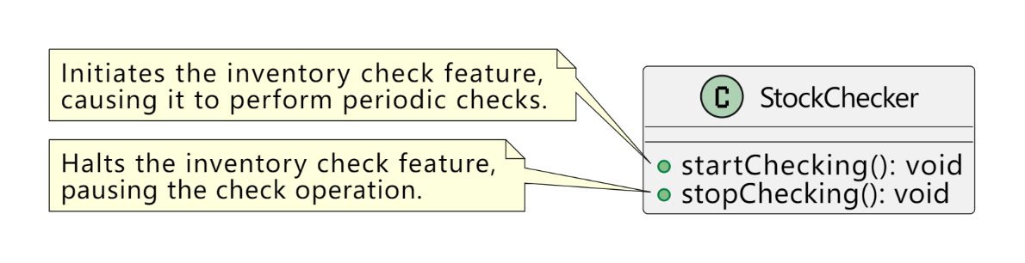
PART.5
METHOD
METHOD AND USAGE
Method Descriptions:
The StockChecker::startChecking() method initiates a timer or thread in the background, calling the check method at specified intervals.
The StockChecker::stopChecking() method stops the timer or thread, temporarily suspending the inventory check feature.
Usage Example:
InventoryManager inventoryManager;
inventoryManager.addItem("vaccine", 50);
StockChecker stockChecker(inventoryManager, "vaccine", 10);
stockChecker.startChecking(); // Start the inventory check feature
PPT模板 http://www.YPPPT.com/moban/

Slide 8
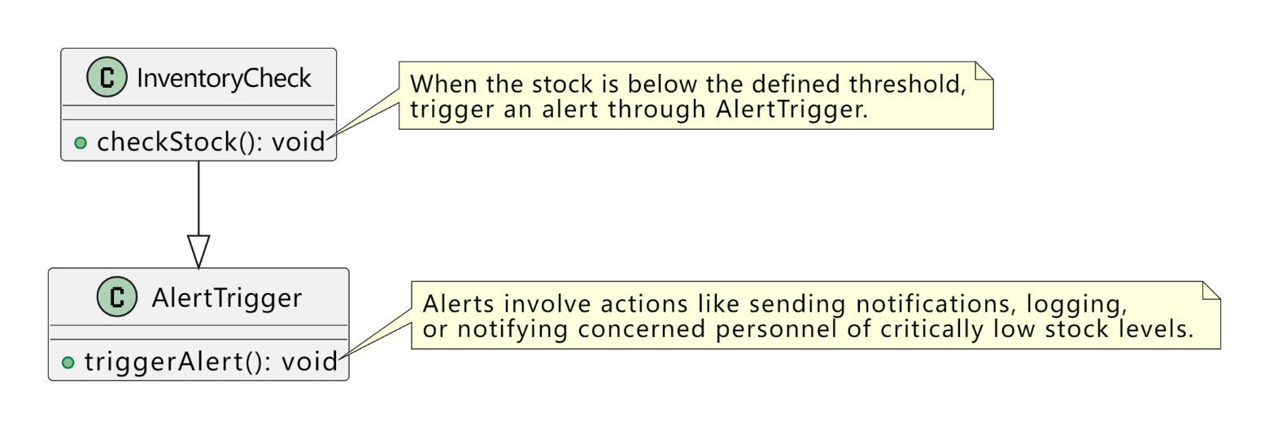
PART.6
ALERT LOGIC
ALERT TRIGGER LOGIC:
When the check identifies that the stock is below the defined threshold, the inventory check feature triggers an alert.
Alerts can involve actions such as sending notifications, logging, or other relevant operations to notify concerned personnel of critically low stock levels.
Notes:
https://www.ypppt.com/

Slide 9





THANK YOU FOR WATCHING
KARINA AND VINCENT

